Slide 1


Claims Against Big Tech
Giles Wheeler KC, Niamh Cleary, and Jacob Turner, Fountain Court Chambers

Slide 2

Topics covered in this seminar
Class actions and representative claims against Big Tech
AI litigation: Drivers v Uber and Ola Cabs cases
The ICO’s new focus on algorithmic decision-making and implications for private claimants
The Rohingya Facebook Claim

Slide 3
Class actions and representative claims: an overview
Representative claims:
Governed by CPR 19.6
Representative claimant must have the “same interest” as those on whose behalf the claim is being brought
Google LLC v Lloyd [2021] UKSC 50

Slide 4
Class actions and representative claims: an overview
Collective proceedings
Governed by s.47B of the Competition Act 1998
Proceedings can be “opt-out” or “opt-in”

Slide 5
Class actions and representative claims: an overview
Threshold requirements for certification under s.47B:
Just and reasonable to appoint the class representative
Claims raise the same, similar, or related issues of fact or law
Methodology for assessing damages on a class wide basis that is “sufficiently credible or plausible to establish some basis in fact for the commonality requirement”: London & South Eastern Railway Ltd v Gutmann [2022] EWCA Civ 1077

Slide 6
The class action landscape post Merricks
Merricks v Mastercard [2020] UKSC 51
8 (at least) new class actions issued against “Big Tech” in 2021-2022
  2 against Apple
  3 against Google
  1 against Meta
  1 against Qualcomm
  1 against Sony

Slide 7
Why is the CPO process so popular in Big Tech claims?
Renewed focus by competition enforcement agencies on “tech giants” (i.e., Meta, Google, and related industries)
Features of the CPO process favourable to mass claims against tech giants

Slide 8
Looking forward: conceptual and practical problems
Conceptual: new markets and problems of market definition
Practical
  Carriage disputes
  Overlapping claims
Is there a risk of the pendulum swinging back?

Slide 9
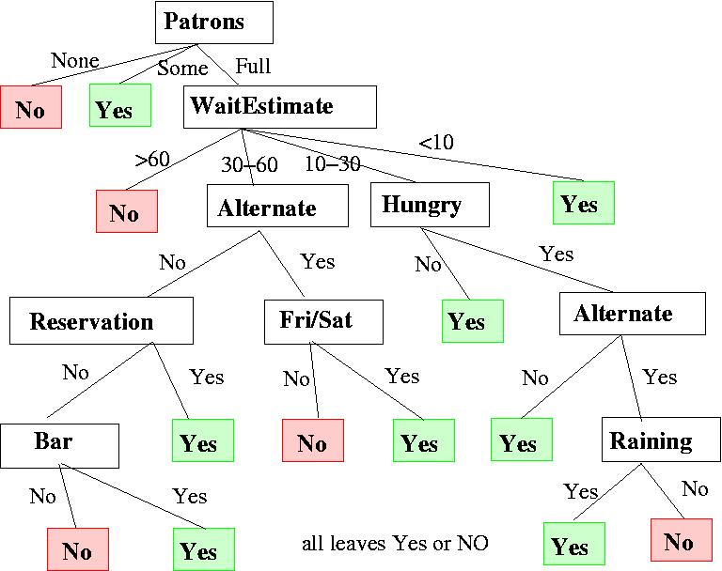
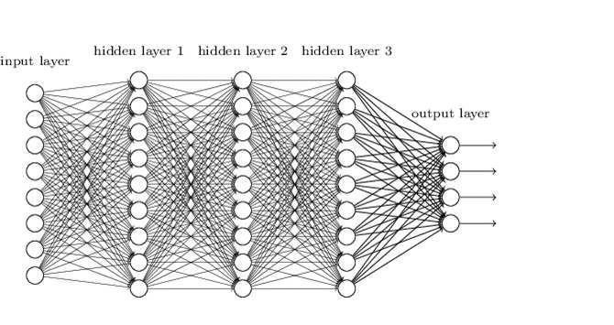
Defining AI
Traditional Programs
AI Programs
Automated
Deterministic
Logic based
Explanations can be provided easily
Autonomous
Non-deterministic
Non-linear
Transparency/ explainability difficult

Slide 10
Defining AI
        European Commission – AI Act
        Draft of 25 November 2022
        Art. 3 (1) ‘artificial intelligence system’ (AI system) means
        a system that is designed to operate with elements of autonomy
        and that,
        based on machine and/or human-provided data and inputs, infers how to achieve a given set of objectives using machine learning and/or logic- and knowledge based approaches, and produces system-generated outputs such as content (generative AI systems), predictions, recommendations or decisions, influencing the environments with which the AI system interacts;

Slide 11
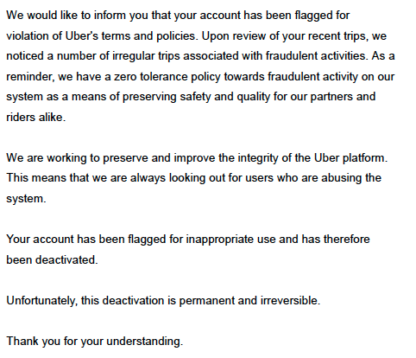
Drivers v Uber BV and Ola Cabs BV
Notification to Drivers

Slide 12


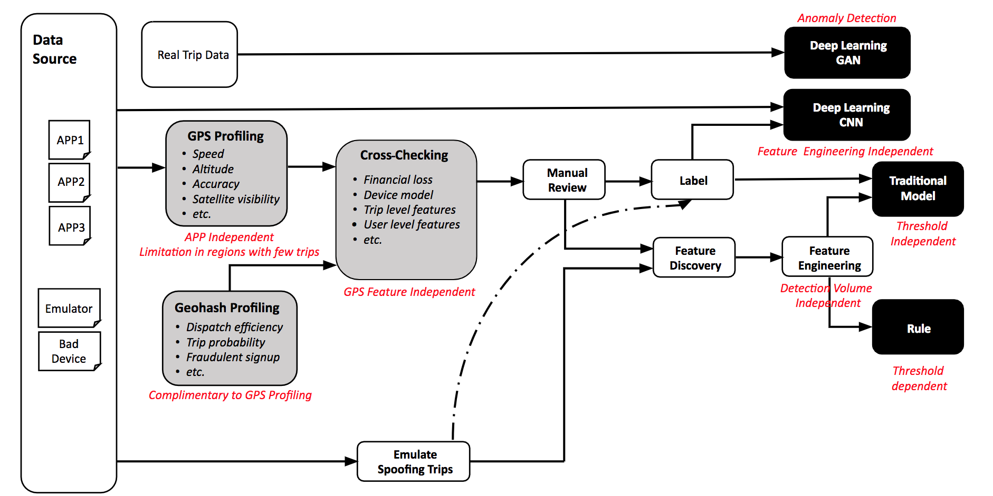
Source: https://eng.uber.com/advanced-technologies-detecting-preventing-fraud-uber/

Slide 13
GDPR Right to an explanation
Articles 13(2)(f), 14(2)(g) and 15(1)(h) GDPR require data controller to:
…provide the data subject with the following further information necessary to ensure fair and transparent processing: the existence of automated decision-making, including profiling… and, at least in those cases, meaningful information about the logic involved, as well as the significance and the envisaged consequences of such processing for the data subject.
Recital 71:
In any case, such processing should be subject to suitable safeguards, which should include specific information to the data subject and the right to obtain human intervention, to express his or her point of view, to obtain an explanation of the decision reached after such assessment and to challenge the decision.

Slide 14
Right not to be subject to automated decision-making
Article 22 GDPR:
1. The data subject shall have the right not to be subject to a decision based solely on automated processing, including profiling, which produces legal effects concerning him or her or similarly significantly affects him or her.
2. Paragraph 1 shall not apply if the decision:
(a) is necessary for entering into, or performance of, a contract between the data subject and a data controller;
(b) is authorised by Union or Member State law to which the controller is subject and which also lays down suitable measures to safeguard the data subject's rights and freedoms and legitimate interests; or
(c) is based on the data subject's explicit consent.

Slide 15
The first instance judgments
Court rejects companies’ attempt to rely on security concerns to block disclosure of meaningful information on fraud detection systems
                Drivers succeed under Article 15 information request against Ola:
                “Ola must provide [the drivers] with information that makes the choices made, data used and assumptions on the basis of which the automated decision is taken transparent and verifiable. Ola must communicate the main assessment criteria and their role in the automated decision to [the drivers], so that they can understand the criteria on the basis of which the decisions were taken and they are able to check the correctness and lawfulness of the data processing”
                Uber persuades court that decisions on fraud detection are not taken solely by AI, because human moderators check and verify the results

Slide 16
ICO’s Focus on Algorithms
3-year plan released in July 2022
Focus includes:
  “looking at the use of algorithms within the benefits system;
  considering the impact the use AI in recruitment could be having on neurodiverse people or ethnic minorities, who weren’t part of the testing for this software;”
                Deputy Commissioner, Stephen Bonner (October 2022): “As it stands, we are yet to see any emotion AI technology develop in a way that satisfies data protection requirements, and have more general questions about proportionality, fairness and transparency in this area.”
                Powers to constrain AI use may be reduced in UK by new Data Protection and Digital Information Bill

Slide 17
Rohingya Google Claim
A novel duty of care?
Tension between the traditional view of social media “platforms” and Meta’s use of algorithms

Slide 18
London
Fountain Court Chambers
Fountain Court, Temple, London, EC4Y 9DH
T +44 (0)20 7583 3335
Singapore
Fountain Court Chambers
10 Collyer Quay, Ocean Financial Centre #40-38, Singapore 049315
T 65 6808 6611
www.fountaincourt.co.uk

